Slide 1
Example slide resource for lectures/seminars

Slide 2
Notes – anything in red is a note, and can be deleted or needs content adding/changing
Use accessible slides – like the design here! – Arial or comic sans, 22pt+, black text on pastel background.
Send students a pre-module questionnaire ahead of their first seminar/lecture with you [see next two slides]
Consider your own needs, and normalise practices that accommodate students and staff e.g. Dr Farahar wears ear plugs during table discussion when she leads a seminar group
Make inclusive expectations of both your students and yourself
Consider neurodivergent friendly ice-breakers – if you have to use them!

Slide 3
[email template to send to all students, not just ILPs, ahead of first seminar]
Dear ??? seminar students (Groups 4; 11; 13; 15; 18 etc.),
I am ???, your seminar leader week commencing ??/??/??.
I wanted to introduce myself before we meet next week, and to inform students with inclusive learning plans (ILPs) I have acknowledged these.
Firstly, what I would really like is for all students who might have participation and/or accommodation needs, both the students with and those without ILPs, to let me know what would help you learn best in my seminars. This could be anything, e.g. "please make sure the lights are not too bright", "I will occasionally need to leave the room", "I like to use a fidget spinner to concentrate/when I'm anxious". No need to do this if these are things I am already aware of via ILPs. Could students detail anything you would welcome during seminars by going to the following Moodle link (only I can see the contributions): [seminar leader name] seminar groups - pre-attendance notes [link to Moodle feedback form/DoodlePoll]
I ask that people use the Moodle link for this and not email me with replies, as there are a lot of you and only one of me, and that would be a lot of emails.
Secondly, please familiarise yourself with Moodle for our seminars.
Last, should you need to attend an alternative session as a one-off, turn up to the alternate session and request to fill in the appropriate form from the seminar leader. Please do not email me to explain you will be absent or need to attend a different session, the process mentioned is sufficient.
Looking forward to meeting you all!
All the best,
???

Slide 4
[Moodle pre-seminar feedback form/DoodlePoll]
This feedback form is for my ??? seminar students, groups 4; 11; 13; 15; & 18 etc.
Please complete this as a pre-attendance feedback form following the advice I gave via email. Note that only I can see the responses and you are automatically anonymous. If you are happy for me to know who you are please leave your name in with your comment/s.
Q) Students who might have participation &/or accommodation needs, both the students with and those without ILPs, please let me know what would help you learn best in my seminars. This could be anything, e.g. "please make sure the lights are not too bright"

Slide 5
[seminar leader name] seminar groups – introductions
Email
[Chloe]/she/her/they/them

Slide 6
Safety
Fire exits
Refuge points, refuge points for disabled people
Fire alarms tested Tues 9am

Slide 7




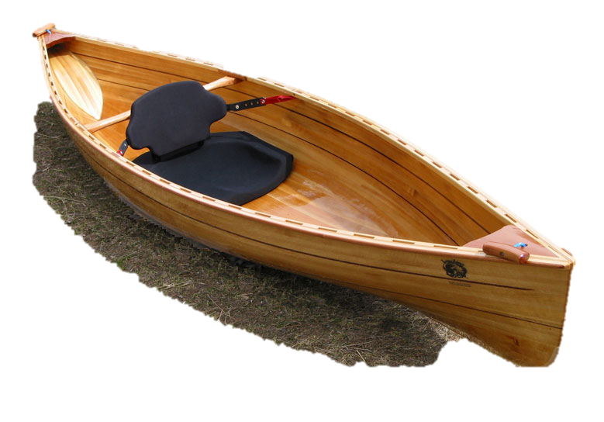
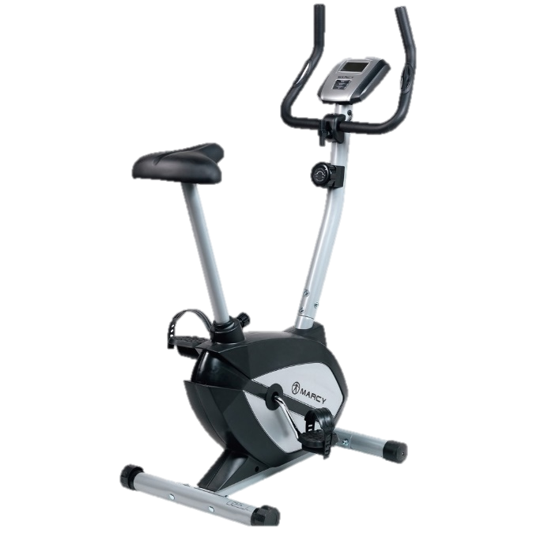




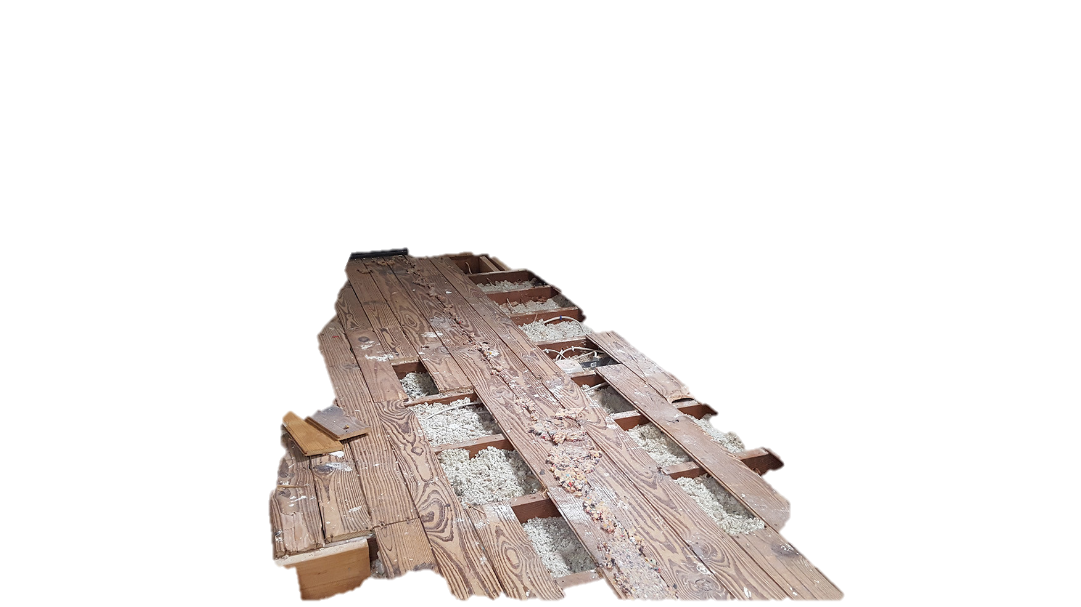


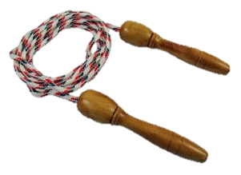

Ice-breakers (bleurgh!) cont.
[This is Chloe’s ice-breaker for the group, where it’s not about socialising e.g. asking about the person, or personal questions, but in small groups or pairs coming up with the most creative way of getting the bananas down]

Slide 8
Student accommodation needs and seminar leader/lecturer needs
I asked for people to let me know how these sessions could be structured to help you all participate in your own ways [email to all students ahead of first seminar to ask for anonymous needs not covered by ILPs for ALL students, email template end of slides].
  [List any requests emailed by students ahead of the session/s]
I have my own accommodation needs, which include sessions not getting too loud: please don’t talk at once – I cannot separate noises easily. Be mindful of noise level. I may leave the room during table discussion, or wear ear plugs to dampen the noise.

Slide 9
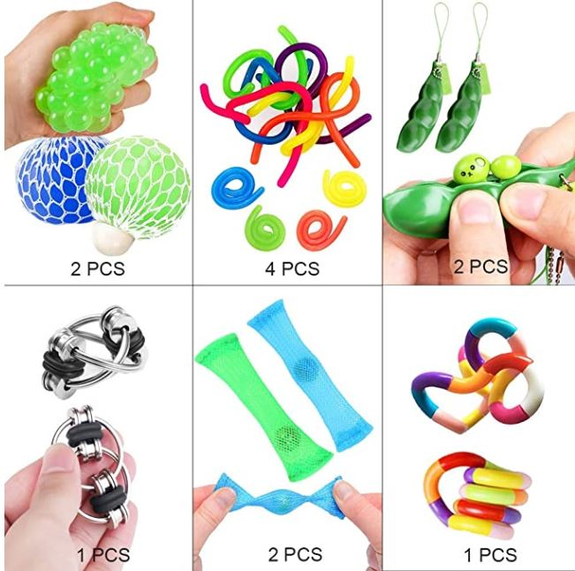
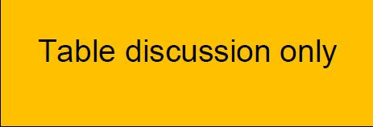
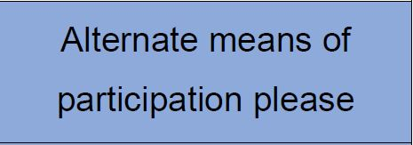

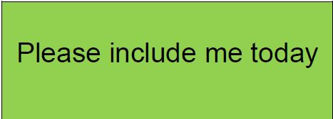
Seminar expectations
Expectations of students
  To do your best to be prepared
  To engage as much as possible in each session (in your own way)
  Be aware of noise levels
  Expectations for myself
    Respect your right to participate as you choose – participation cards
    Make reasonable adjustments to my teaching
    Provide information for seminars with sufficient time for you to digest it

Slide 10
How we can work – inclusion & accessibility
Everyone to contribute, however:
Participation cards each session – everyone has different needs on different days [important that ALL students pick up a card every week, even if it’s the same one, to normalise the practice for all, this also helps leaders know who they can ask to participate]

Slide 11
Fidgeting and focus
Stim objects are OK and encouraged in my seminars – they may help people to concentrate.
Examples of – and link to Amazon wishlist for inspiration https://www.amazon.co.uk/hz/wishlist/ls/ZWP04WTRP531?ref_=wl_share
Notes:
[stim objects pic https://www.amazon.co.uk/dp/B07MY5ZGRB/?coliid=I3UTQUGAB8YLCK&colid=ZWP04WTRP531&psc=1&ref_=lv_ov_lig_dp_it

Slide 12
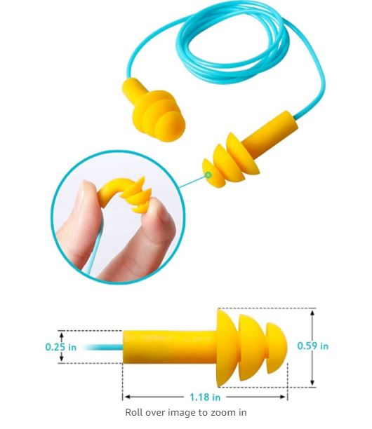
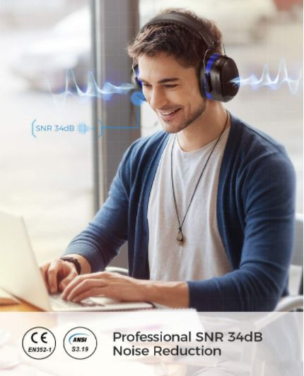
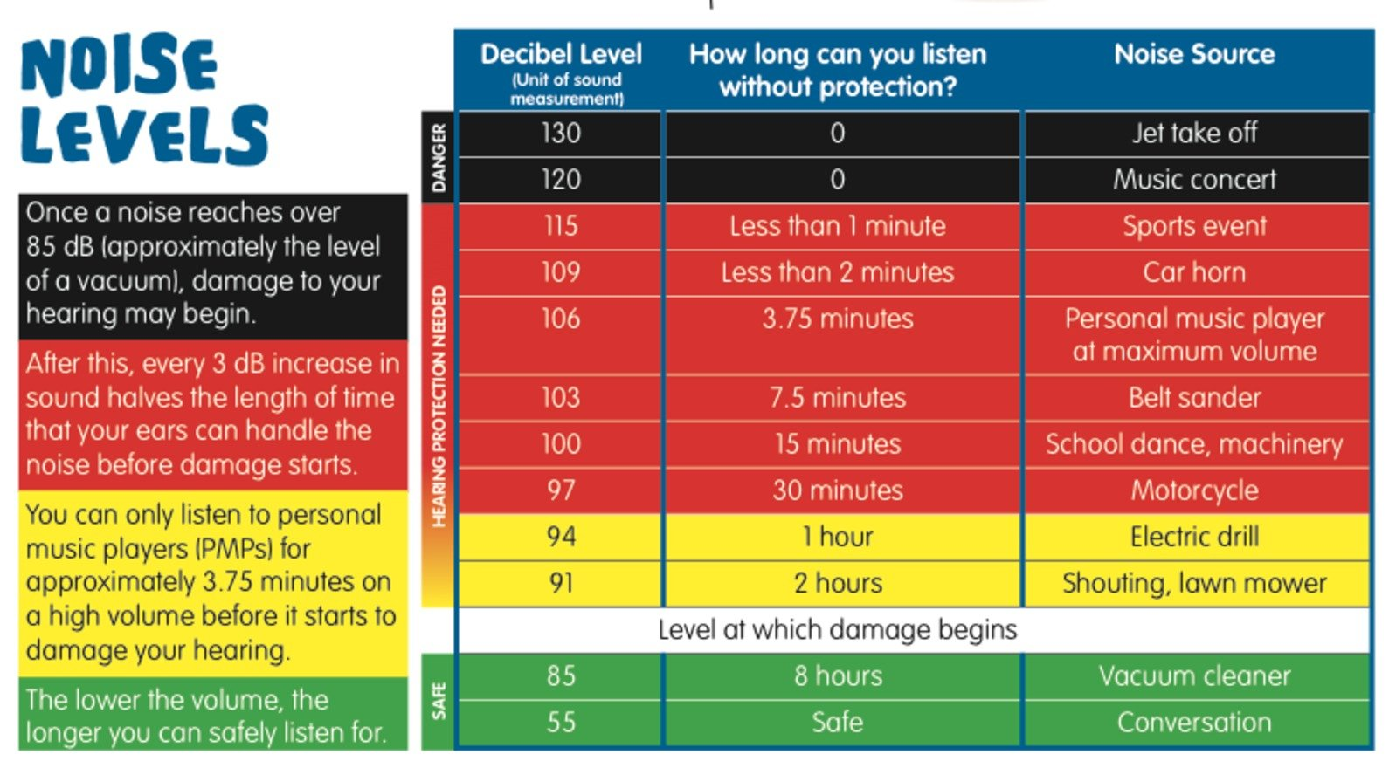
Noise volume and complexity
[What’s acceptable to accommodate your student/s, but also you as a seminar leader/lecturer?]
Ear plugs, ear defenders [but not headphones, wireless or otherwise?] allowed.
Ear defenders link (note that there are different decibel limits, and some defenders are fine for listening to someone speak, they just muffle enough that the person can concentrate and not get overwhelmed):
https://www.amazon.co.uk/dp/B07QQR4294/ref=twister_B07TYW6FBT?_encoding=UTF8&psc=1
Ear plugs link:
https://www.amazon.co.uk/dp/B07DBWFGQX/?coliid=IBHOH8KBURAY8&colid=ZWP04WTRP531&psc=1&ref_=lv_ov_lig_dp_it
Notes:
https://www.shponline.co.uk/procurement-guides/hearing-protection-a-how-to-guide-for-those-choosing-ear-defenders/ - link to decibel level picture source

Slide 13
Signposting
Signpost – school’s student support officer/s and/or Student Support and Wellbeing – students can go discuss ILP needs even if they’ve never had one before

Slide 14
Ground rules
All adults, if you need to leave the room do so quietly, I don’t need to know why!
Direct all module questions to the MAIN module Moodle Q & A forum [Moodle link] and if that fails, the module convenor directly
  Module name, convenor details for contacting them
  Module name, convenor details for contacting them
  Etc.

Slide 15

Ground rules cont.
One-off requests to attend alternative session – just fill in the appropriate form and hand to me in the session you do attend
Mobiles for accessibility – ask permission if recording seminar/taking pictures (different ethical concerns than lectures) – I won’t be checking why you have mobile, be respectful

