Slide 1

Neurodiversity
Celebration Week
Every brain a gift. Every mind a world.
Dr Chloe Farahar | Aucademy CIC
Presentation created by Dr Chloe Farahar | Aucademy CIC | aucademy.co.uk | © Dr Chloe Farahar – please credit when sharing
Copyright Dr Chloe Farahar | Aucademy CIC

Slide 2



What is Neurodiversity?
Neurodiversity is the diversity of human brains and minds – a natural, healthy, and valuable form of human variation. No brain is 'wrong'.
The Autistic community, inLv server (early/mid 1990s) | Walker (2014)
Population concept
Not a condition
A natural spectrum
Neurodiversity belongs to groups and species – all of humanity is neurodiverse, just as all of humanity is biologically diverse.
Neurodiversity is not a diagnosis or a disorder. It is simply the recognition that brains vary, just as bodies do.
There is no single 'normal' brain. What we call 'typical' is a statistical majority, not a standard to aspire to.
Copyright Dr Chloe Farahar | Aucademy CIC

Slide 3
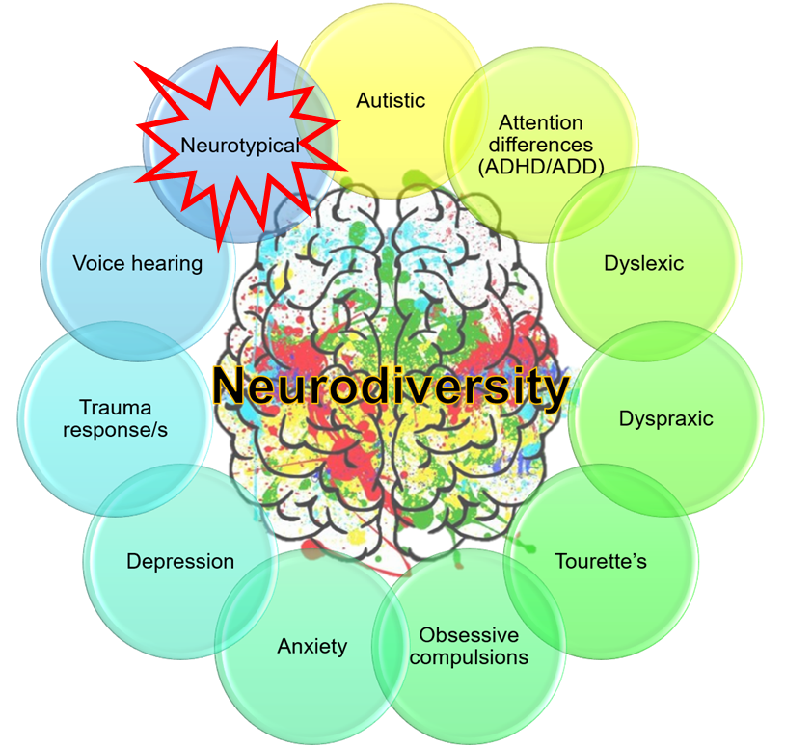
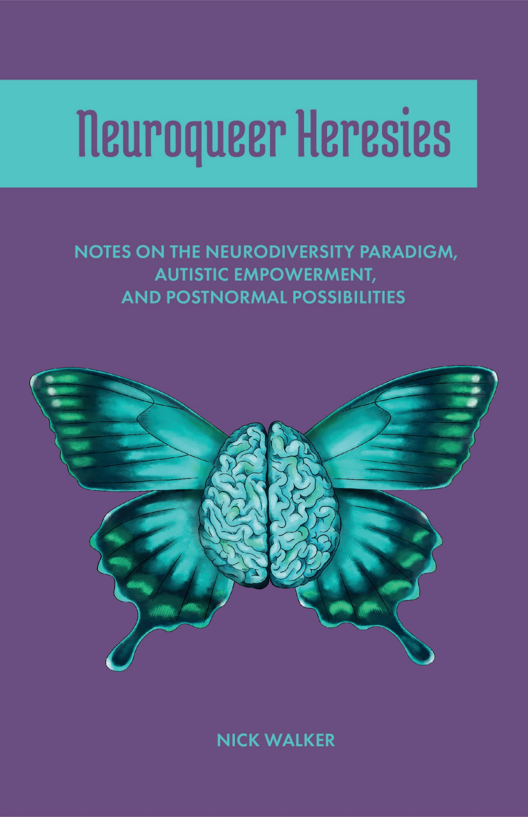
An Important Distinction
NEURODIVERSITY
NEURODIVERGENCE
A property of groups and populations.
All humans are part of the neurodiverse tapestry of our species.
Think of it like biodiversity – it describes the variation across a whole ecosystem, not an individual organism. ⚠ You cannot be 'a neurodiverse person' in the same way you cannot 'be biodiversity'.
A property of individuals.
A neurodivergent person is someone whose brain works in ways that differ significantly from what is considered neurotypical or neuronormative. Term coined by Kassiane Asasumasu (1999/2000).
Simply put: neurodivergence refers to a person; neurodiversity is a characteristic of a group.
Copyright Dr Chloe Farahar | Aucademy CIC

Slide 4
Innate Neurodivergence
Present from birth – a fundamental part of how a person's brain is wired.
Autistic
ADHD / Polyennic
Differences in sensory processing, communication, thinking, and social interaction. A neurodevelopmental identity, not a disorder.
Attention works differently – not a deficit, but a different motivational and attentional system driven by interest and novelty.
Dyslexia
Dyspraxia / DCD
A difference in how written language is processed. Often paired with strong verbal reasoning and creative thinking.
Differences in motor planning and coordination, sometimes affecting sequencing, organisation, and spatial awareness.
Dyscalculia
Tourette's / Tic disorders
A difference in number processing and mathematical reasoning, distinct from poor maths teaching or low effort.
Involuntary movements or vocalisations (tics). Highly variable – many people with Tourette's live rich, full lives.
Synaesthesia
Congenital Deafness / Blindness
A blending of senses – for example, hearing music and seeing colour, or reading words and tasting flavours.
From birth, shaping an entirely different sensory world and often a distinct cultural identity.
Copyright Dr Chloe Farahar | Aucademy CIC

Slide 5
Acquired Neurodivergence
Brain differences that develop after birth – through injury, illness, experience, or intensive practice.
Neurodivergence is not only something you are born with. Life itself can reshape our experiences of and interactions with the world and others – and this is neither a weakness nor a failure.
Traumatic Brain Injury
Stroke
Changes in cognition, memory, personality, or sensory processing following head trauma.
Can affect language, movement, memory, and executive function in lasting ways.
Post-Traumatic Stress
Acquired Deafness or Vision Loss
PTS reshapes the nervous system's threat responses, attention, and memory processing.
Sensory change after birth leads to significant neurological reorganisation.
Chronic Pain
Neurodegenerative Conditions
Long-term pain physically changes brain structure and affects cognition and mood.
Including Parkinson's, MS, and dementia – progressive changes in neurological function.
Depression & Psychosis
Meditation Practice
Mental health conditions can fundamentally alter perception, cognition, and experience.
Intensive practice changes brainwave patterns and sensory processing – acquired neurodivergence!
Copyright Dr Chloe Farahar | Aucademy CIC

Slide 6
Being Autistic
Autistic people have a neurodevelopmental difference – Autistic brains work differently to non-Autistic brains. There is no one way to be Autistic. (Autistic Self Advocacy Network, 2020)
Sensory world
Communication differences
Often processes sensory input very differently – sounds, textures, lights, smells may be experienced more intensely or in entirely different ways.
Not deficits – differences. Autistic communication is direct, detailed, and honest. The 'double empathy problem' (Milton) reminds us this is a two-way gap.
Monotropism
Autistic ≠ distress
A tendency to focus deeply on one thing at a time – like a powerful spotlight rather than a diffused lamp. This creates expertise, passion, and depth.
Being Autistic is not the same as suffering. Distress arises from environments that do not accommodate Autistic ways of being – not from autism itself.
Bottom-up processing
Masking costs
Starting with details and building to the 'big picture', rather than the top-down processing typical of non-Autistic people.
Unconsciously suppressing natural Autistic traits to meet neurotypical expectations is exhausting and harmful. It leads to burnout, anxiety, loss of identity, and for many, suicidality.
Always use identity-first language: Autistic person, not 'person with autism'
Copyright Dr Chloe Farahar | Aucademy CIC

Slide 7
ADHD – or Polyennic Minds
'Attention Deficit Hyperactivity Disorder' is a misleading name. The attention is not missing – it is everywhere at once. Polyennic (from Greek: many thoughts) is a more accurate framing.
Attention is different, not absent
Dopamine-driven
Polyennic people give intense, deep attention to things that interest them – hyperfocus is real. The challenge is attention regulation, not absence.
The brain is wired to seek novelty, interest, challenge, and urgency. Tasks without these qualities are genuinely harder – not a character flaw.
Executive function
Rejection sensitivity
Planning, starting, stopping, and switching tasks can be genuinely difficult. This is neurological, not laziness.
Many Polyennic people experience RSD (Rejection Sensitive Dysphoria) – intense emotional responses to perceived criticism or failure, likely due to real experiences of being rejected.
Copyright Dr Chloe Farahar | Aucademy CIC

Slide 8
Spiky Profiles: Strengths AND Challenges
Every neurodivergent person – indeed, every person – has a unique combination of strengths and difficulties. This is a spiky profile.
❌ The myth
✓ The reality
The 'spectrum' is a straight line from 'mild' to 'severe'. A person is either 'high-functioning' or 'low-functioning'.
This is harmful. It flattens complexity, denies support to those labelled 'high-functioning', and denies capability to those labelled 'low-functioning'.
A neurodivergent profile is multi-dimensional – with strengths in some areas, challenges in others, and everything changing over time and context.
The 'rainbow sausage' (Dr Chloe Farahar): our profiles are not static lines but dynamic, ever-changing shapes across time and environment.
Copyright Dr Chloe Farahar | Aucademy CIC

Slide 9
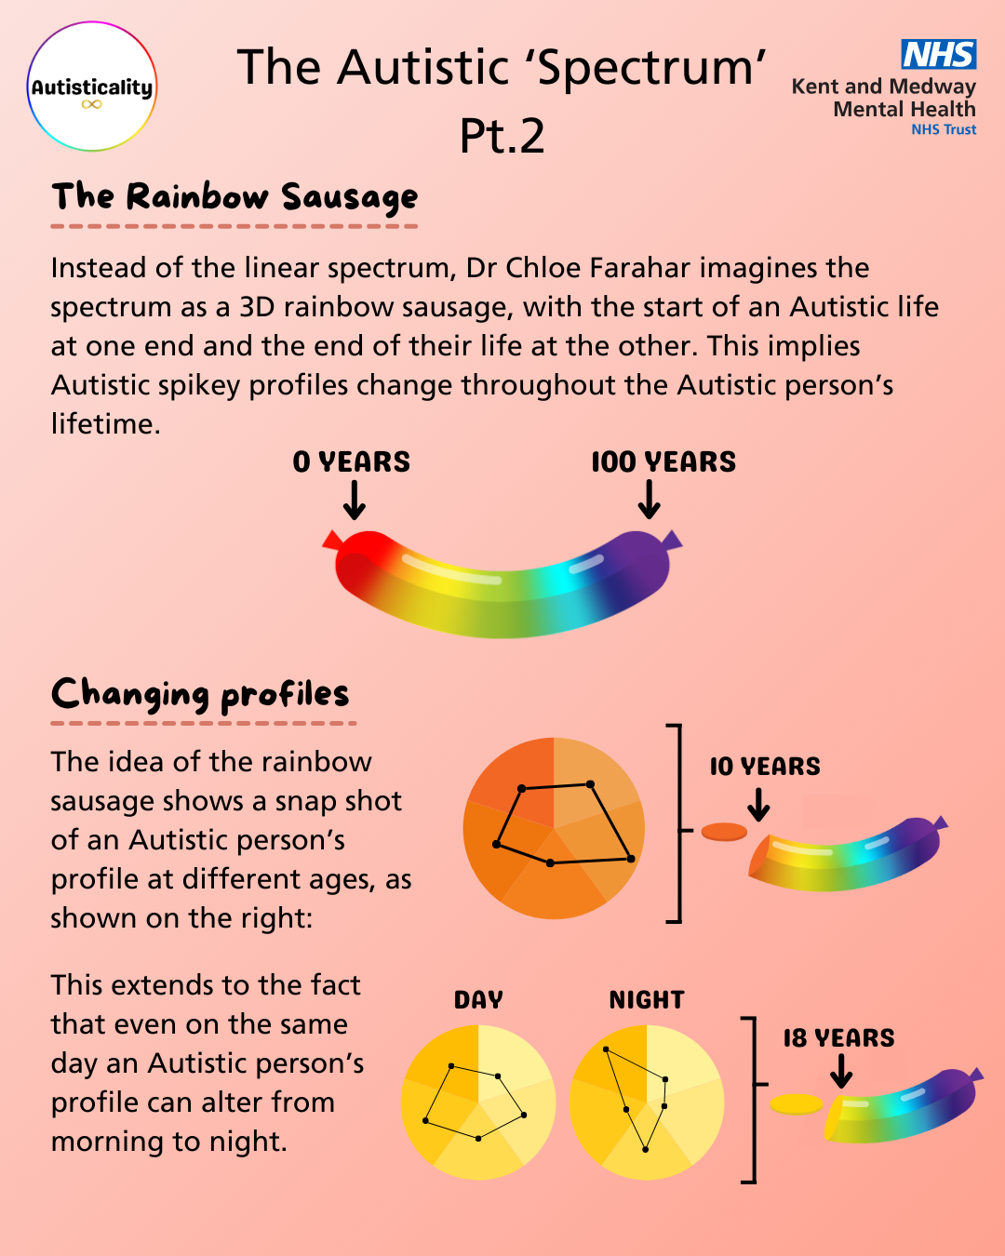
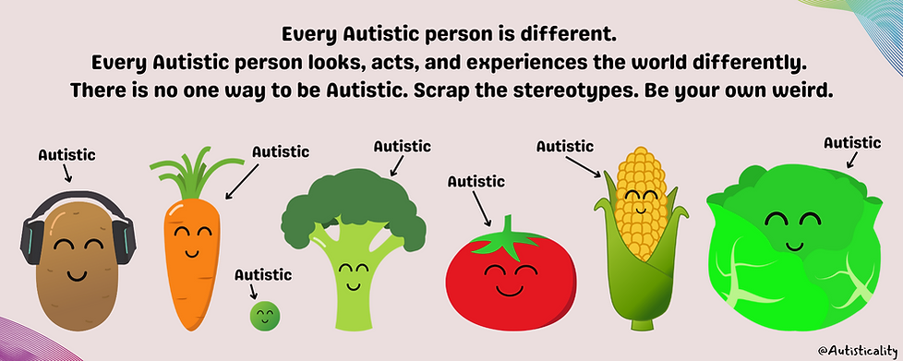

Slide 10

Know Your Profile (need help? Start here! aucademy.co.uk/building-your-autistic-profile-brief-starting-page/ )
Understanding your own neurological profile is the foundation of self-advocacy. You cannot ask for what you need if you do not yet know what you need.
01
Map your senses
02
Track energy and time
03
Identify your strengths
Which environments help you focus? Which overwhelm you? Consider sound, light, temperature, texture, smell. Write it down.
When do you do your best thinking? What drains you quickly? What restores you? Patterns matter.
What do you find easy that others find hard? Where does deep focus come naturally? What do you notice that others miss?
04
Name your challenges
05
Consider context
06
Seek community
Without shame – what is genuinely harder for you? What tasks take twice the energy? Where do you need support?
Your profile is not fixed. Stress, sleep, environment, and relationships all shift what you can do. Context is everything.
Connecting with others who share your neurodivergence is powerful. Lived experience is the richest source of self-knowledge.
Copyright Dr Chloe Farahar | Aucademy CIC

Slide 11






Your Rights as a Neurodivergent Person
Equality Act 2010 (UK): Neurodivergent experiences are frequently classified as disabilities under this Act, requiring employers and service providers to make reasonable adjustments.
Right to reasonable adjustments
Right to request assessment
Employers and educational institutions must make changes to remove substantial disadvantage – this is a legal duty, not a favour.
You have the right to seek a formal diagnosis or assessment. This may unlock support, reasonable adjustments, and self-understanding.
Right to disclose on your terms
Right to accessible information
You are not legally required to disclose your neurodivergence to employers. Disclosure decisions are yours alone.
Information should be available in formats you can access – plain English, Easy Read, audio, visual, or other formats.
Right to advocacy
Right to be free from discrimination
You may bring a support person or advocate to meetings with employers, healthcare providers, or educational institutions.
Direct and indirect discrimination on grounds of neurodivergence is unlawful. Harassment and victimisation are also prohibited.
Copyright Dr Chloe Farahar | Aucademy CIC

Slide 12
Reasonable Adjustments: What Do They Look Like?
Environment
Communication
Reduced lighting or window blinds
Quieter workspace or noise-cancelling headphones
A predictable, consistent physical space
Fragrance-free workplace policy
Flexible seating options including standing desks
Written agendas sent in advance
Information in plain English or Easy Read
Extra processing time in meetings
Email or written communication as default
No expectation of eye contact
Time and structure
Assessment and learning
Flexible start and finish times
Clear, predictable routines
Advance notice of change
Chunked tasks with clear deadlines
Protected planning time
Extra time in exams or assessments
Alternative formats (oral, practical, written)
Assistive technology access
Notes provided in advance
Feedback in writing, not only verbally
Copyright Dr Chloe Farahar | Aucademy CIC

Slide 13
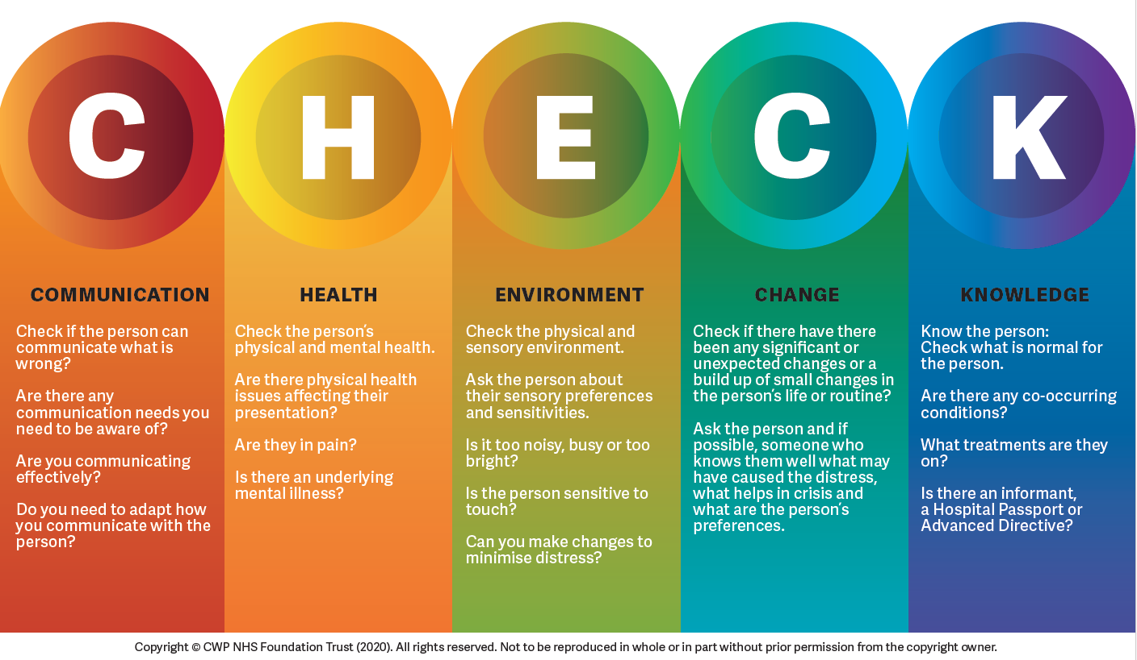

Communicating Your Needs
Knowing your rights is the first step. Communicating them clearly is the next. Here are practical strategies – you do not have to disclose everything to ask for what you need.
The 'I work best when…' frame
Put requests in writing
'I work best when I have written instructions / advance notice / a quiet space.' You are describing needs without necessarily disclosing a diagnosis.
Writing protects you. Submit reasonable adjustment requests in writing (email is fine), keep a copy, and ask for written confirmation of any agreement.
Use tools to
Communicate
Name the barrier, not just the diagnosis
CHECK healthcare tool
CHECK employment tool
CHECK education tool
'Bright overhead lighting affects my concentration significantly' is often clearer and more actionable than 'I am Autistic'.
Bring support
Know what 'no' looks like
You are entitled to bring a friend, colleague, or advocate to meetings where your needs will be discussed. Use this right.
An employer refusing a reasonable adjustment without evidence that it causes 'disproportionate burden' is likely unlawful. Seek advice from ACAS, the Equality Advisory Service, or a union.
Copyright Dr Chloe Farahar | Aucademy CIC

Slide 14
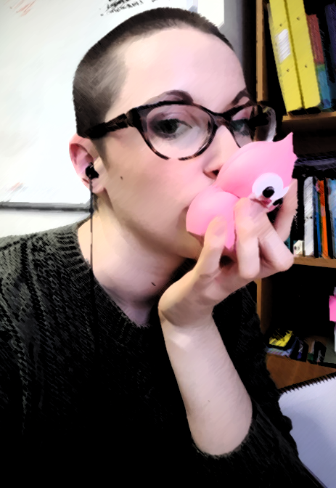
Stimming Is Valid – Respect the Stim
Stimming (“self-stimulatory behaviour”) describes the repetitive movements, sounds, or sensory-seeking behaviours that help neurodivergent people – and all humans – regulate their nervous systems. It is not a symptom to be eliminated.
Types of stimming
Harmful stimming: a clinical distinction
Types of stimming
Movement: rocking, flapping, spinning, bouncing, pacing
When natural stims are suppressed – through shame, stigma, or behaviour programmes – they can become harmful (skin-picking, head-banging, hair-pulling).
Harmful stimming is clinically distinct from self-harm. It is a distress signal – not a behaviour to punish, but an indication that the person's environment is not working for them.
Source: Kapp et al. (2019); Marsden et al. (2025)
Sound: humming, singing, echolalia, internal sound stimming (echolagia)
Visual: watching patterns, glittery objects, lights
Tactile: squeezing, fidgeting, stroking textures
Smell/taste: strong or specific sensory inputs
Everyone stims – doodling, hair-twirling, leg-bouncing
Copyright Dr Chloe Farahar | Aucademy CIC

Slide 15
Creating Neuroaffirming Environments
When a flower doesn't bloom, you fix the environment – not the flower (Alexander Den Heijer)
Presume competence
Reduce sensory barriers
Communicate clearly
Never assume a person cannot understand or achieve. Support people to show what they can do, in the way that works for them.
Quiet spaces, adjustable lighting, reduced fragrance, fidget tools, and permission to move all reduce cognitive load for neurodivergent people.
Use plain language. Give written instructions. Offer advance notice. Avoid metaphor, sarcasm, or ambiguity as a default mode.
Build in flexibility
Centre lived expertise
Interrogate your assumptions
Flexible attendance, timing, format, and communication styles benefit everyone – not only those with identified neurodivergences.
Neurodivergent people are the experts on their own experience. Include them in decisions about their care, support, and environments – and pay them.
Many 'professional norms' – eye contact, small talk, a linear working day – are neurotypical/ neuronormative norms, not universal human standards.
Copyright Dr Chloe Farahar | Aucademy CIC

Slide 16

This Week, I Pledge To…
Use affirming language
Challenge a stereotype
Ask, not assume
Autistic person. Dyslexic person. Not 'suffers from', not 'has autism'. Words carry power.
When I hear 'all Autistic people are good at maths' or 'they don't look neurodivergent' – I will gently push back.
Rather than guessing what support someone needs, I will ask. I will listen. I will not make it awkward.
Make space for difference
Learn something new
Share this knowledge
I will not penalise stimming, non-standard communication, or different ways of being present.
I will read one article, watch one video, or have one conversation that deepens my understanding of neurodivergence.
I will pass something from what I have learnt today on to one other person this week.
Copyright Dr Chloe Farahar | Aucademy CIC

Slide 17
Everybody's weird.
You just have to find your group of weird.
Aucademy CIC
If You're Autistic or experience a Learning Disability …
Autisticality
aucademy.co.uk
Free education on Autistic experience.
YouTube & Facebook: @Aucademy
autisticality.co.uk
Neurodivergence-affirmative resources
including ADHD/Polyennic education
Get involved & up to date on the improvement work co-developed with Dr Chloe Farahar for Kent & Medway Mental Health NHS Trust
Equality Advisory Service
ACAS
Dr Chloe Farahar
equalityadvisoryservice.com
Free advice on your rights under
the Equality Act 2010
acas.org.uk
Workplace rights guidance including
reasonable adjustments
linktr.ee/docfarahar
Research, speaking, training,
and the Autistic Discovery Journey
Presentation created by Dr Chloe Farahar | Aucademy CIC | aucademy.co.uk | © Dr Chloe Farahar – please credit when sharing
Copyright Dr Chloe Farahar | Aucademy CIC

Slide 18
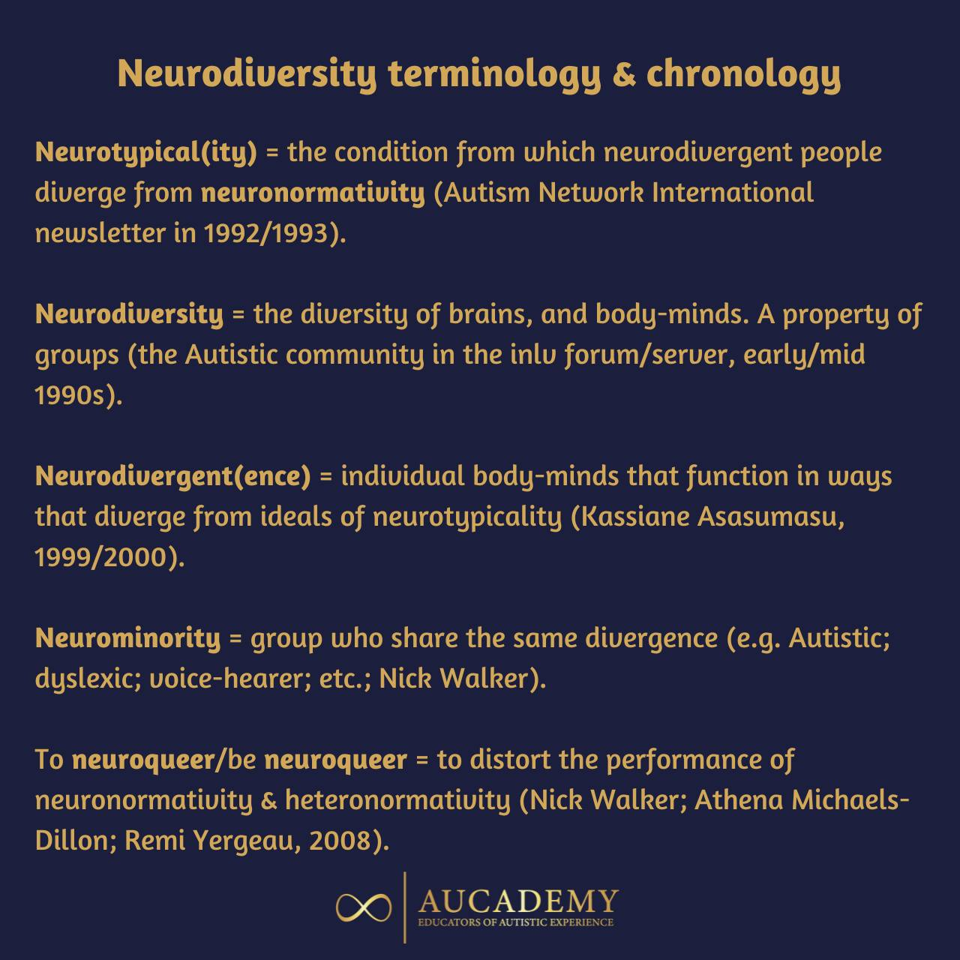
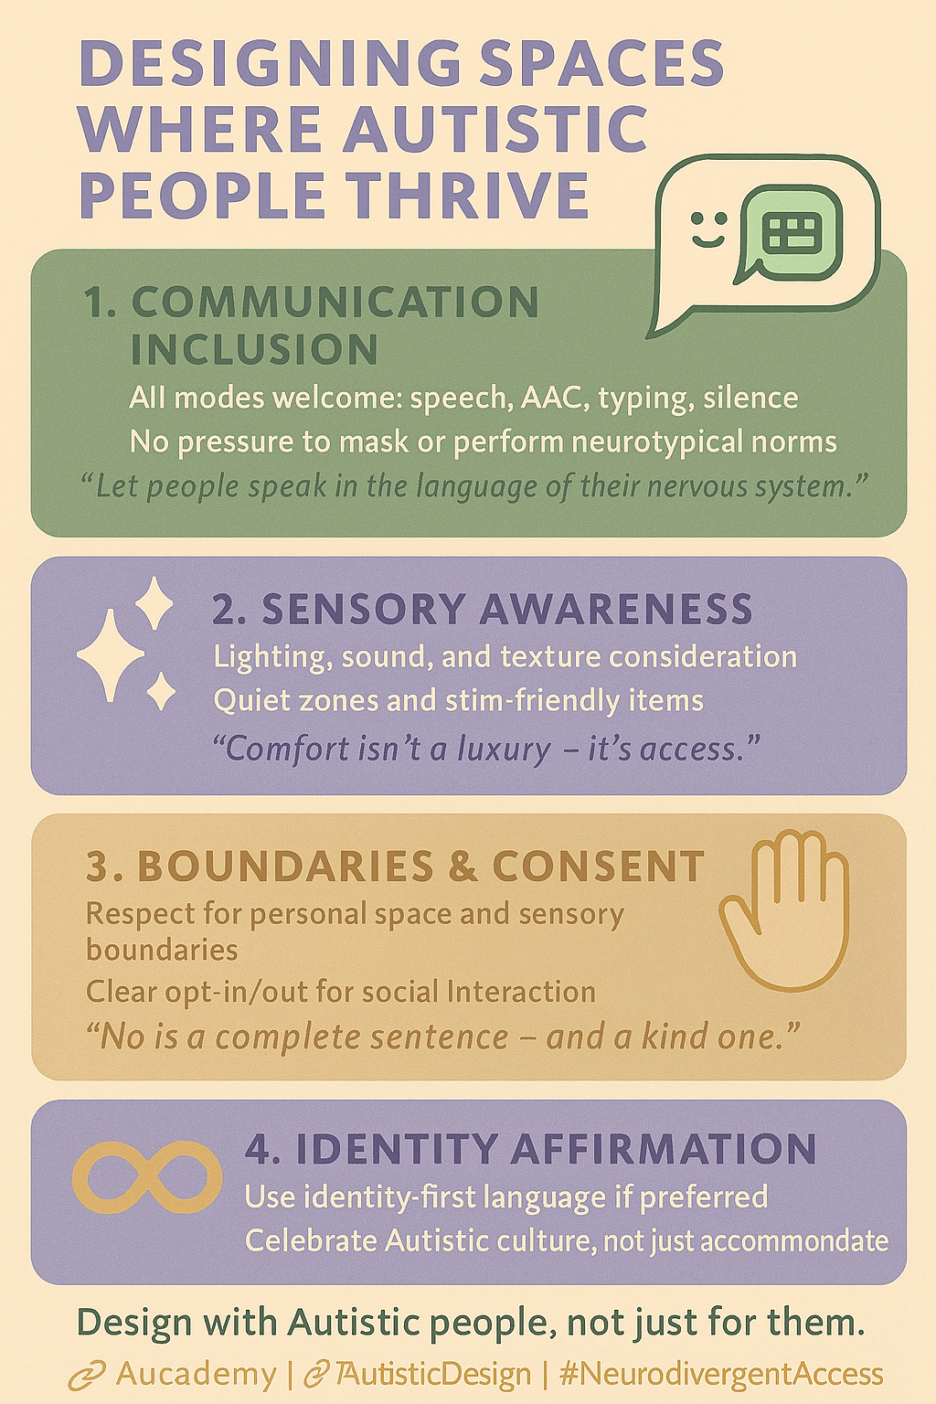
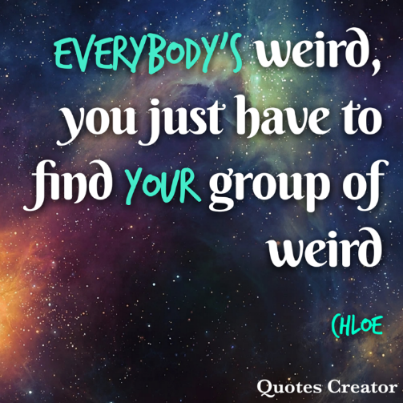
Sharable Resources…
Copyright Dr Chloe Farahar | Aucademy CIC

Slide 19
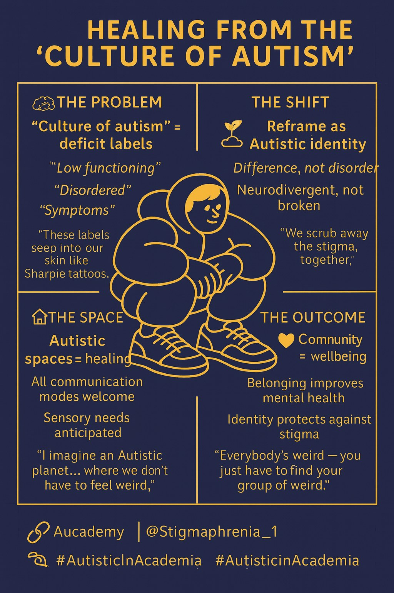
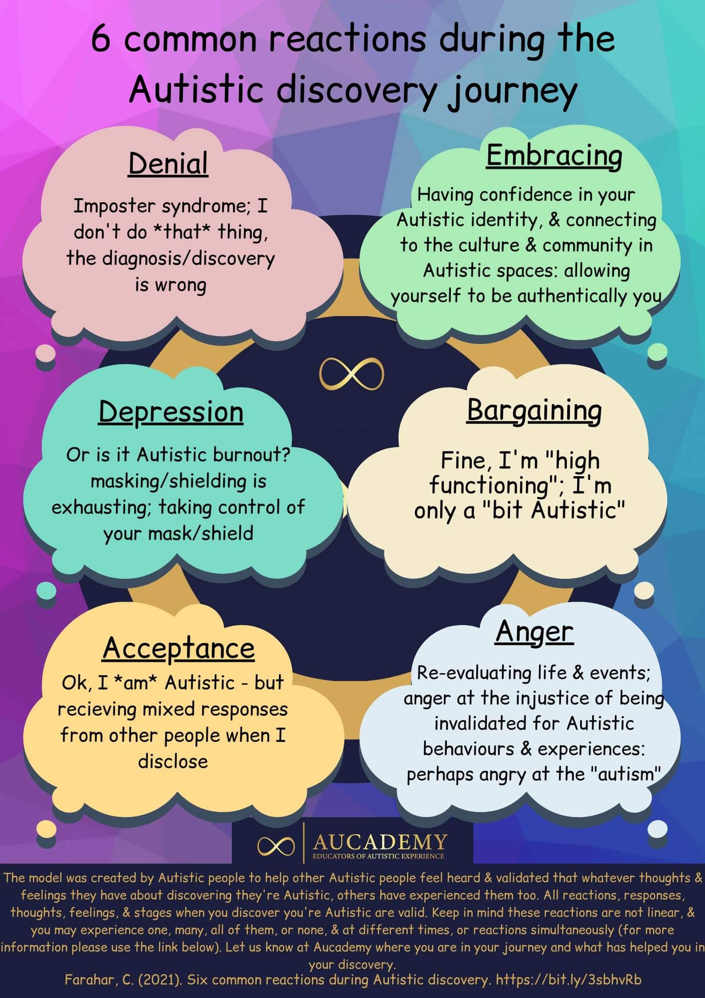
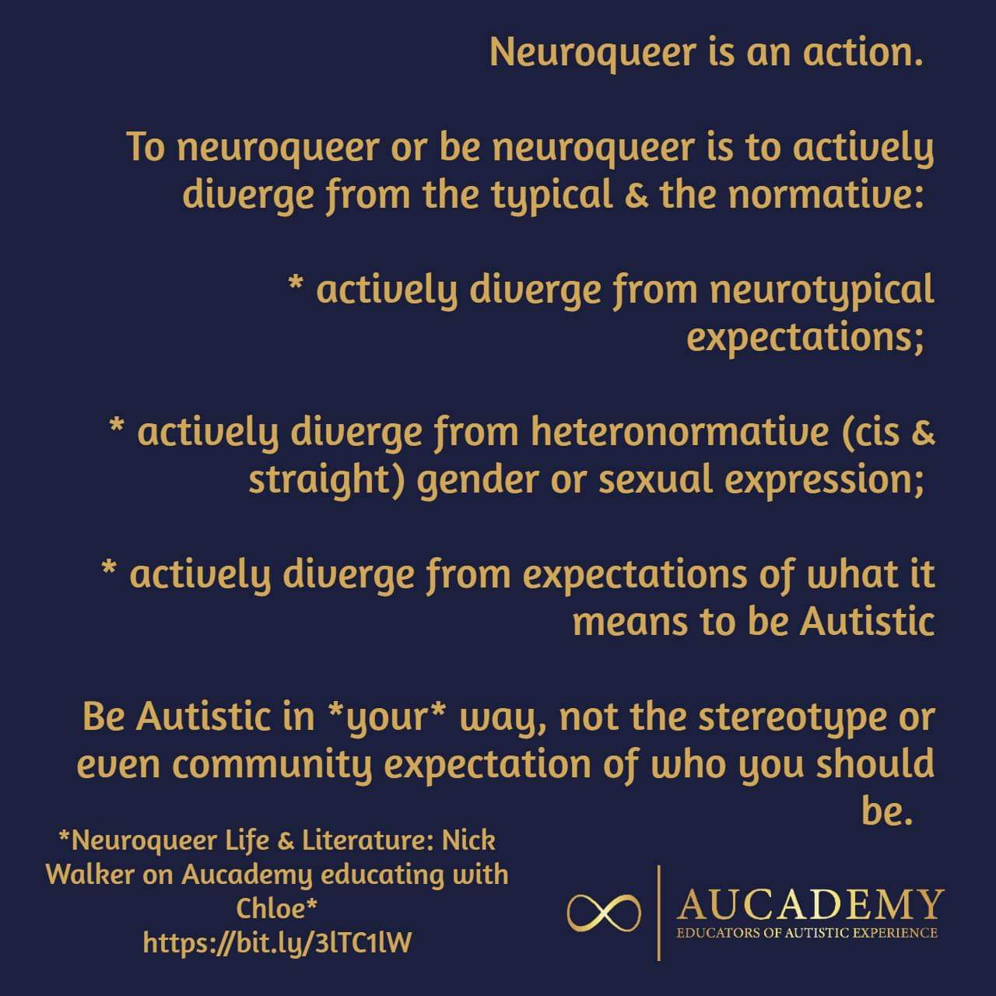
Sharable Resources…
Copyright Dr Chloe Farahar | Aucademy CIC

Slide 20
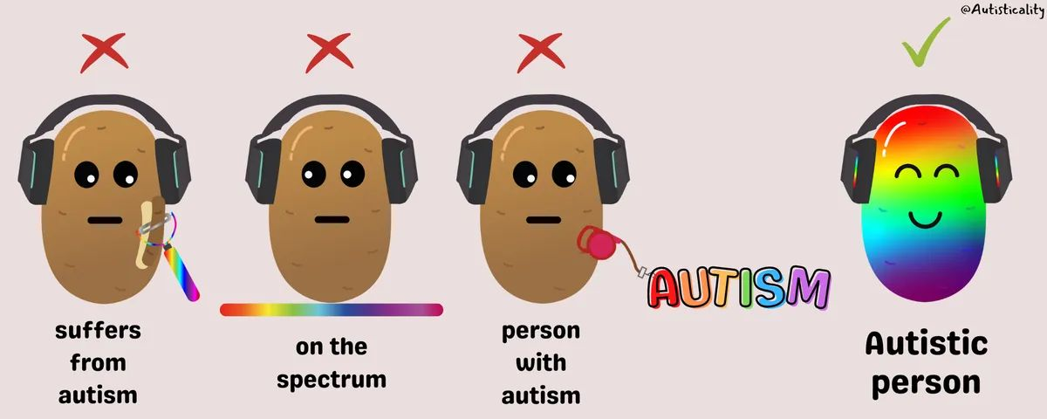
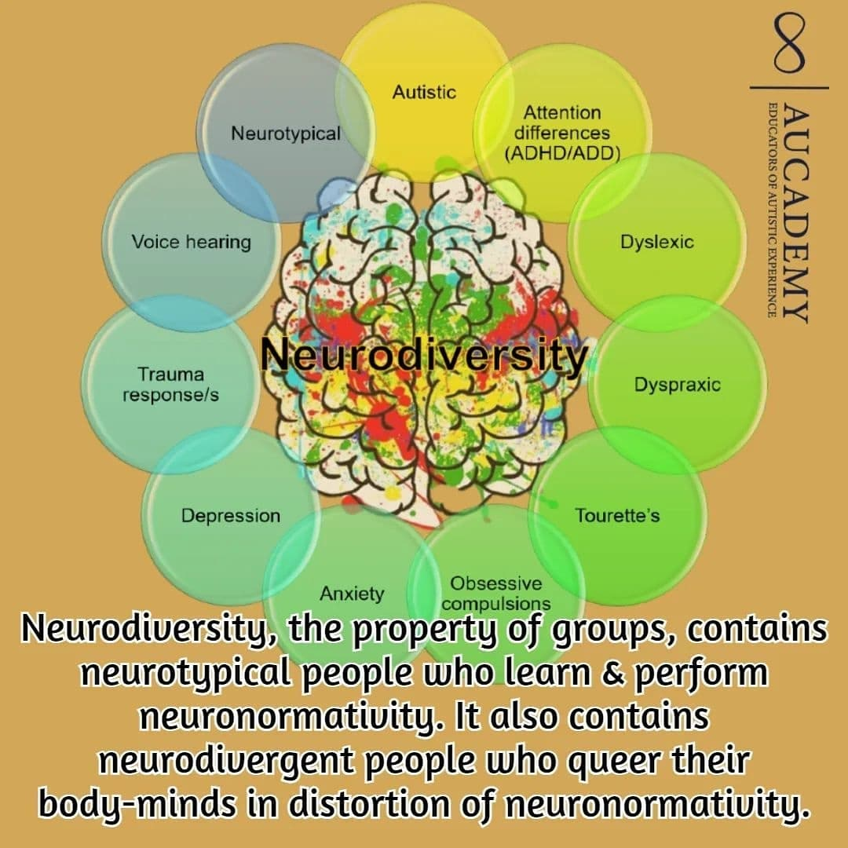
Sharable Resources…
Copyright Dr Chloe Farahar | Aucademy CIC

